Slide 1
Physics – A Level Taster
January 22, 2021
http://www.youtube.com/watch?v=THNPmhBl-8I
“It’s not exactly rocket science”
- well, actually, it is!

Slide 2
Rocket Science
Where it starts - Equations of motion
Observation - Monkey and the hunter
Key principle – Vertical and horizontal motion are independent of one another
Where it leads - Projectile motion

Slide 3
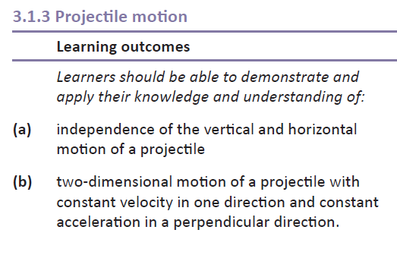
Specification Links

Slide 4
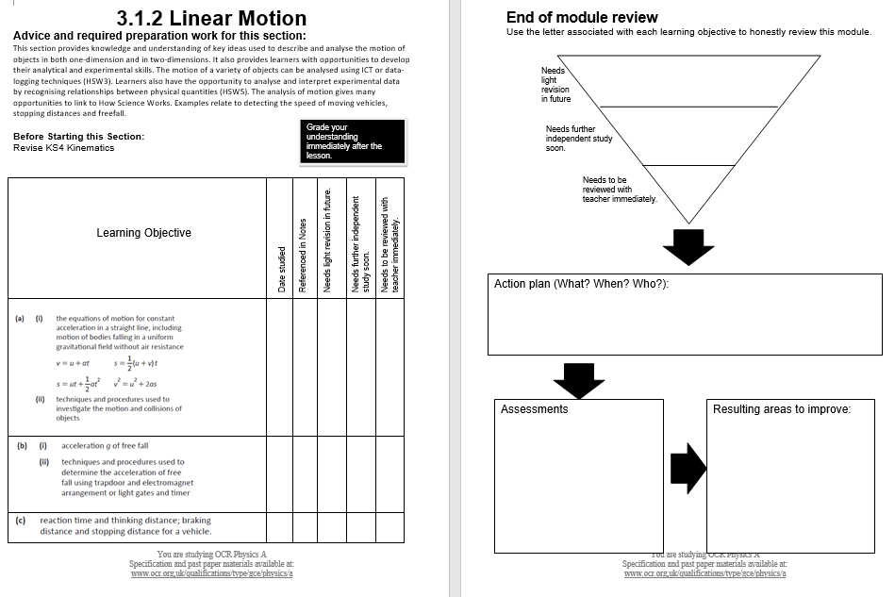
Keeping Track

Slide 5
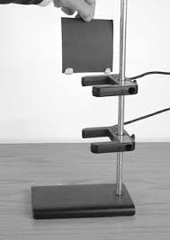
Prior Learning
Practical Endorsement Task
Measuring acceleration due to gravity ‘g’

Slide 6
Equations of Motion
Equations of motion
These equations apply to motion where the acceleration is constant!
We will therefore ignore the effect of air resistance for the time being.
s = distance travelled (m)
u = initial velocity (ms⁻¹)
v = final velocity (ms⁻¹)
a = acceleration (ms⁻²)
t = time (s)

Slide 7
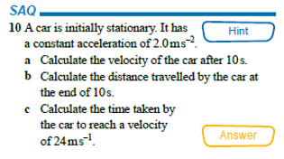
Example
s = ?
u = 0ms⁻¹
v = ?
a = 2ms⁻²
t = 10s
v = u + at
v = 0 + (2 x 10)
v = 20ms⁻¹
s = ut + ½ at² (u =0 since it starts at rest)
s = ½ x 2 x 10²
s = 100m
v = u + at
24 = 0 + (2 x t)
t = 24/2 = 12s
s =
u = 0
v = 24ms⁻¹
a = 2ms⁻²
t = ?

Slide 8
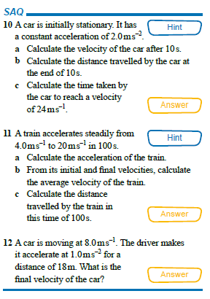
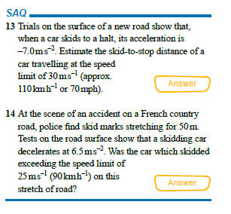
Now try the rest…

Slide 9
Answers

Slide 10
Answers

Slide 11
Answers

Slide 12
Answers

Slide 13
Answers

Slide 14
Equations of motion
More Practice questions: Equations of motion
An airplane accelerates down a runway at 3.20 m/s2 for 32.8 s until is finally lifts off the ground. Determine the distance travelled before take-off.
2. A race car accelerates uniformly from 18.5 m/s to 46.1 m/s in 2.47 seconds.
Determine the acceleration of the car and the distance travelled.
3. A feather is dropped on the moon from a height of 1.40 meters. The
acceleration of gravity on the moon is 1.67 m/s². Determine the time for the
feather to fall to the surface of the moon.
An engineer is designing the runway for an airport. Of the planes that will use the airport, the lowest acceleration rate is likely to be 3 m/s². The take off speed for this plane will be 65 m/s. Assuming this minimum acceleration, what is the minimum allowed length for the runway?

Slide 15
Rocket challenge
Design an build a rocket designed to reach the greatest height under a pressure of 60psi.
Team work
Managing your time
Dexterity.

Slide 16
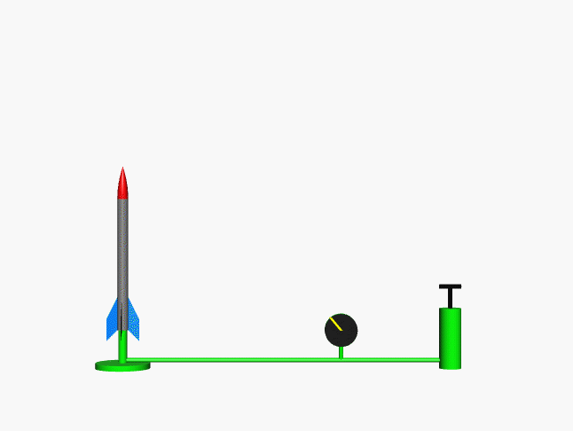
How high will an air rocket go?
Imagine launching an air rocket vertically – can we work out how high it will go without measuring it?

Slide 17
How high will your rocket go?
All you need to do here is measure the time for the rocket to reach its maximum height.
Suppose the time is measured at 1.6s.
The height can then be calculated from
s = ½ at²
s = ½ (9.81) (1.6)²
s = 12.6m
So the rocket will reach a height of 12.6m.
s= ?
u= ?
v= 0ms⁻¹
a= 9.81ms⁻²
t = measure
Can you think of a reason why the rocket might not quite reach this height in reality?

Slide 18
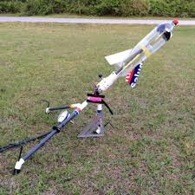
What if the rocket is fired at an angle?

Slide 19
Monkey and Hunter

Slide 20
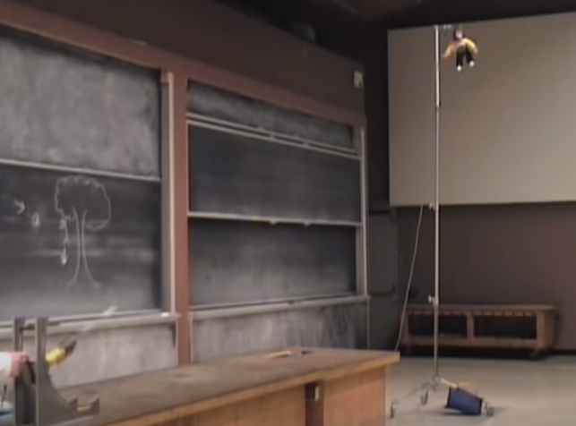
Link to MIT Video

Slide 21
Monkey and Hunter
Why is the result of this experiment so important?

Slide 22
Monkey and Hunter
This experiment shows that the horizontal (sideways) motion does not affect the vertical (up and down) motion?
This idea is very important when we look at projectile motion

Slide 23
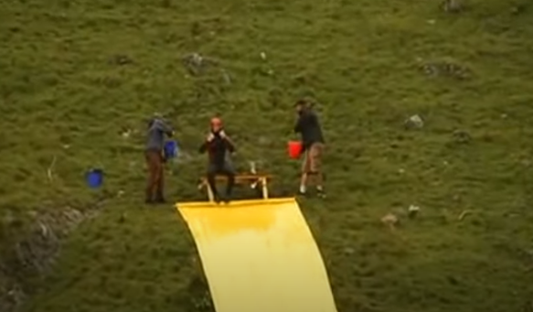
Real or Fake?
Link to slip slide video

