Slide 1
Intro to A-Level Media Studies

Slide 2
A-Level Media Intro
If you choose to study A-Level Media you will study the following topics:
Television
Online Media
Advertising and Marketing
Film Marketing
Magazines
Newspapers
Social and Participatory media
Music Video
Radio
Video Games

Slide 3
A-Level Media Intro
You will examine how social, historical, political and economic contexts affect media production.
You will also learn lots of academic media theorists that you will apply to the four key concepts of media language, representations, audience and industry.

Slide 4
Activity 1
Music Video Representation Analysis:
Watch the following music video:
https://www.youtube.com/watch?v=VYOjWnS4cMY&ab_channel=ChildishGambinoVEVO
Key Questions:
How is America represented in this music video?
Try to consider the historical, social/cultural contexts in your thinking!

Slide 5
Activity 1
Music Video Representation Analysis:
Key Question:
How is America represented in this music video?
Historical Context to consider…
You should have thought about:
Slavery and black African Americans being represented as the antagonists (villains), evil, criminalised and often depicted as dehumanised in many media texts throughout the 20th and 21st Century.

Slide 6
Activity 1
Music Video Representation Analysis:
Key Question:
How is America represented in this music video?
Social/Cultural Context to consider…
You should have thought about:
Black African Americans are often poorer and therefore lower down the socio-economic scale compared to whites. This forces many to live in poorer neighbourhoods with less appealing housing and can result in lower levels of literacy/education which results in poorer paid employment.
Many American police forces have been known to be institutionally racist and racist in their arrest/treatment of blacks (stemming back to slavery and the Jim Crow days of the Black Civil Rights Movement in the 1960’s).
Events in the 21st Century have highlighted this discriminatory treatment still such as the murder, at the hands of white police officers, of George Floyd (May 2020).
Events such as the one mentioned above, in addition to countless others, caused much anger and resentment amongst black communities in American society and caused mass protests/riots across vast areas of the United States. Race is still very much an unequal and volatile situation in American society today.

Slide 7
Activity 2
Advertising and marketing Media Language Analysis:
Read the following link regarding how to deconstruct an advert:
http://resource.download.wjec.co.uk.s3.amazonaws.com/vtc/2014-15/Int_Media/unit2/unit2.html#page1

Slide 8
Activity 2
Advertising and marketing Media Language Analysis:
The following print adverts demonstrate the importance of having a concept (key idea) behind an advertising campaign.
Analyse the following questions for each of the three advert:
•How does each advert work?
•What is each advert communicating? What does it say about the product? (Connotations given off)
•How is appeal created? (USP)
•Who would the advert appeal to and why?

Slide 9
Activity 2 – Advert 1
Advertising and marketing Media Language Analysis:
Analyse the following questions for each advert:
•How does each advert work?
•What is each advert communicating? What does it say about the product? (Connotations given off)
•How is appeal created? (USP)
•Who would the advert appeal to and why?

Slide 10
Activity 2 – Advert 2
Advertising and marketing Media Language Analysis:
Analyse the following questions for each advert:
•How does each advert work?
•What is each advert communicating? What does it say about the product? (Connotations given off)
•How is appeal created? (USP)
•Who would the advert appeal to and why?

Slide 11
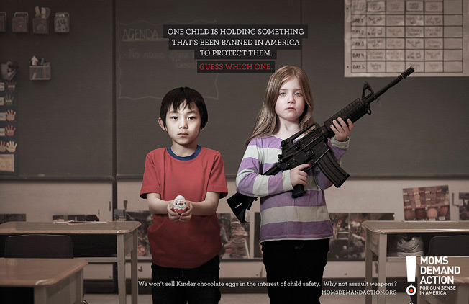
Activity 2 – Advert 3
Advertising and marketing Media Language Analysis:
Analyse the following questions for each advert:
•How does each advert work?
•What is each advert communicating? What does it say about the product? (Connotations given off)
•How is appeal created? (USP)
•Who would the advert appeal to and why?

Slide 12
Summary
In Media you will always consider the:
Connotations presented (meanings/messages of the text) through the media language features.
Representations created and presented to the audience.
Analyse who the intended target audience is and why?
Consider the ownership of the various companies involved in a particular text, as this impacts on the way the text has been produced and presented to the audience (awareness of media industries and their effects/impacts).
Consider PESH contexts (political, economic, social, historical) and relate these, wherever necessary, to the media text being studied.

Slide 13
What will I study?
Component 1:
Written examination: 2 hours 15 mins, 35% of qualification.
Component 2:
Written examination: 2 hours 30 mins, 35% of qualification.
Component 3:
Non-exam assessment: Cross-Media Production, 30% of qualification.

Slide 14
Contact Info
If you wanted to submit any notes from today’s taster session or had any further questions relating to the course please contact me on:
sfearnley@gshs.org.uk

