Slide 1
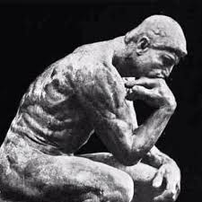
A Level Religious Studies Taster Session
2021

Slide 2
Course Overview
Content Overview
Assessment Overview
1. Philosophy of religion – Taught at Longbenton
Learners will study:
• ancient philosophical influences
• the nature of the soul, mind and body
• arguments about the existence or non-existence of God
• the nature and impact of religious experience
• the challenge for religious belief of the problem of evil
• ideas about the nature of God
• issues in religious language.
Philosophy of religion
120 marks
2 hour written paper
33.3% of total A Level
2. Religion and Ethics – Taught at George Stephenson
Learners will study:
• normative ethical theories
• the application of ethical theory to two contemporary issues of importance
• ethical language and thought
• debates surrounding the significant idea of conscience
• sexual ethics and the influence on ethical thought of developments in religious beliefs.
2. Religion and Ethics
120 marks
2 hour written paper
33.3% of total A Level
3. Developments in Christian Thought – split between LB and GSHS
Learners will study:
• religious beliefs, values and teachings, their interconnections and how they vary historically and in the contemporary world
• sources of religious wisdom and authority
• practices which shape and express religious identity, and how these vary within a tradition
• significant social and historical developments in theology and religious thought
• key themes related to the relationship between religion and society
3. Developments in Christian Thought
120 marks
2 hour written paper
33.3% of total A Level

Slide 3
Component 01: Philosophy of Religion
Pick one of these questions and share your thoughts on it.
These are some of the questions we explore in Philosophy lessons.
Am I real?
What is the meaning of life?
Why does evil exist?
Is there a soul?
What happens when I die?

Slide 4
Component 01: Philosophy of Religion
https://www.youtube.com/watch?v=c3gI9ms8Fdc
In this film Jim Carey plays Truman, a man living a life that is not real. He is completely unaware that his life is the biggest reality TV show ever made. All of those close to him, including his parents, wife and friends are merely actors playing a role.
The film shows his journey to realising the truth.
Watch the clip and discuss:
How do you know that your experiences are real?
Have you ever considered that this world, your life is not real?

Slide 5
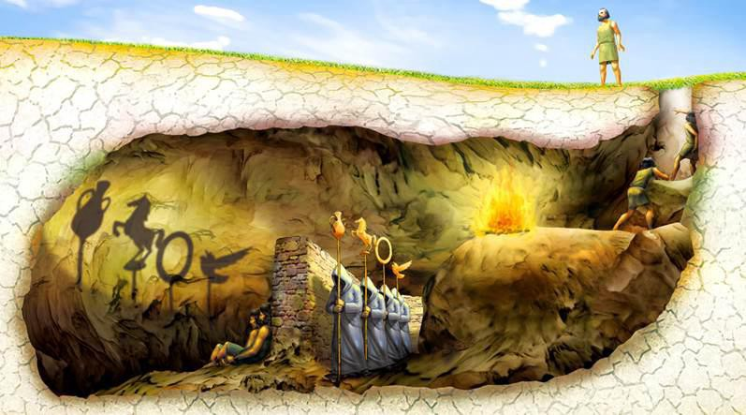
Component 01: Philosophy of Religion
In Year 12 you will study Plato’s allegory of the cave.
Plato was an ancient Greek Philosopher who believed that this life was a shadow of the real one.
He said we are prisoners in a cave who are unable to fully understand the truth.
Watch this clip: https://www.youtube.com/watch?v=1RWOpQXTltA&t=185s
What is the meaning of Plato’s Cave?
What do you think different parts of the story represent?

Slide 6
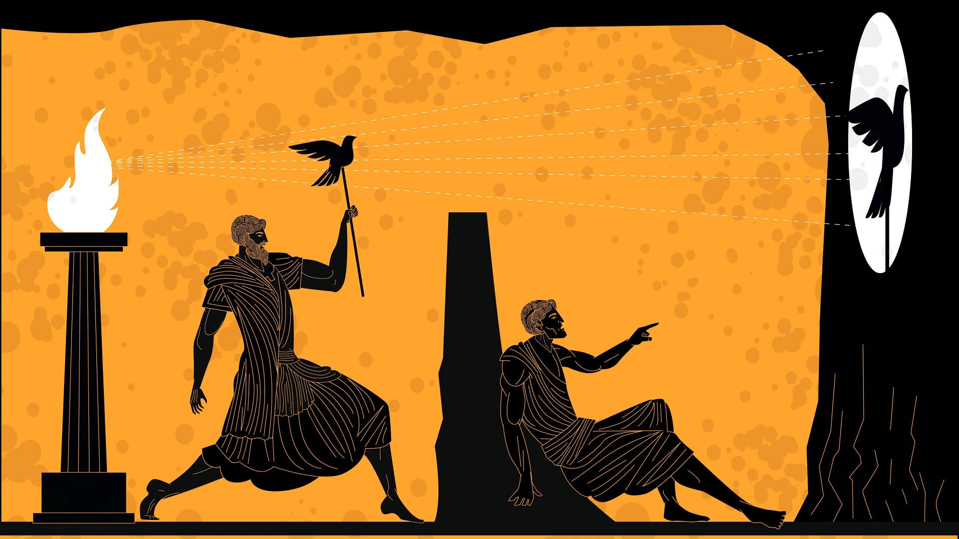
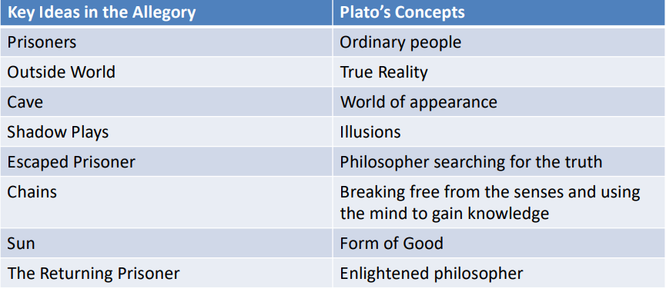
Component 01: Philosophy of Religion
Do you think we can always trust our senses?

Slide 7
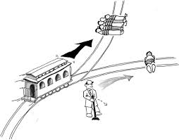
Component 02: Religion and Ethics
The branch of philosophy called ‘ethics’ is concerned with questions concerning how human beings ought to live their lives, and about what is ‘right’ or ‘wrong’.
In your ethics lessons you will examine many different moral dilemmas and apply 4 theories to them.
One of the most well-known ethical dilemmas is called ‘The Trolley Problem’.
Click the links to watch the videos and then complete the tasks on the next slide.
https://www.youtube.com/watch?v=yg16u_bzjPE (TED-Ed)
https://www.youtube.com/watch?v=JWb_svTrcOg (from the Good Place – because sometimes its hard to see how the ethics plays out in real…ish life!)

Slide 8
Followers of Natural Law
When they make an ethical decision they must:
use their reason;
follow the first precept (rule) which is to preserve life;
as far as possible keep to what is natural, i.e. part of the natural scheme of things.
Followers of Situation Ethics
When they make an ethical decision they must:
Do the most loving thing in a situation
Put people before rules
Make the rules in the Bible relative to love
Plot your answer to the Trolley Problem on the continuum and explain your reasoning.
Read the how followers of the 4 theories you will study make moral decisions and plot their answers on the continuum.
Followers of Utilitarianism
When they make an ethical decision they must:
a. decide what action would bring the greatest happiness to the greatest number of people;
b. or what action would bring the least amount of unhappiness to the most people.
c. not take personal relationships into account.
Followers of Kantian Ethics
When they make an ethical decision they must:
act only out of duty, not for any ulterior motive;
only do something that you would be happy for everyone else to do in the same situation.
Don’t treat people as a means to an end.
THE TROLLEY PROBLEM
Flip the switch to save five and kill one.
Don’t flip the switch so five would die and one person survives.

Slide 9
Component 03: Developments in Christian Thought (DCT)
In year 12 you will study the work of Dietrich Bonhoeffer, a theologian and Christian priest, who lived in Germany during the Nazi regime.
Under Adolf Hitler, the Nazis:
Tried to eliminate the Jews.
Killed 85 per cent of Germany's Gypsies.
Sterilised black people, deaf people, physically disabled people and people with hereditary diseases.
Killed mentally disabled babies and adults.
Put homosexuals, prostitutes, Jehovah's Witnesses, alcoholics, pacifists, beggars, hooligans and criminals - who they regarded as anti-social - into concentration camps.
On the next slide are moral principles found in the Bible.
Use them to answer the following question: Would a Christian assassinate Adolf Hitler?

Slide 10
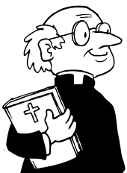
Would a Christian assassinate Adolf Hitler?
Jesus said, “love your neighbour as you love yourself”
Jesus said, “I have not come with peace but with a sword.”
“do not murder”
“let everyone be subject to the governing authorities, who have been established by God”.
Use the quotes to justify whether or not a Christian would assassinate Hitler? Can you argue both yes and no?
Do you agree with them? Justify your opinion:
Jesus said, “You have heard that it was said, ‘Love your neighbour and hate your enemy.’ But I tell you, love your enemies and pray for those who persecute you.”

