Slide 1

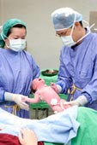

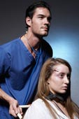



Health and Social Care
SINGLE AND DOUBLE QUALIFICATIONS
HEALTH AND SOCIAL CARE CAMBRIDGE TECHNICALS LEVEL 3
Notes:
1

Slide 2

Careers in the Health and Social Care Sector
Mental health care
geriatrician
Paediatrician
chiropodist
Family planning clinics
Care assistant
Health advisor
Psychologist
Sheltered accommodation
Housing / homelessness services
Foster care
Youth offending services
Nursing
Midwife
Counselling
Child protection
General hospital services
Special education
Youth worker
Day centres
physiotherapist
Nursery nurse
School teacher
Health visitors
Residential care
Complimentary therapist
Occupational therapist
Dentistry
Child and family support services
Speech therapist
Dietician/nutritionist
Environmental Health
Notes:
2

Slide 3
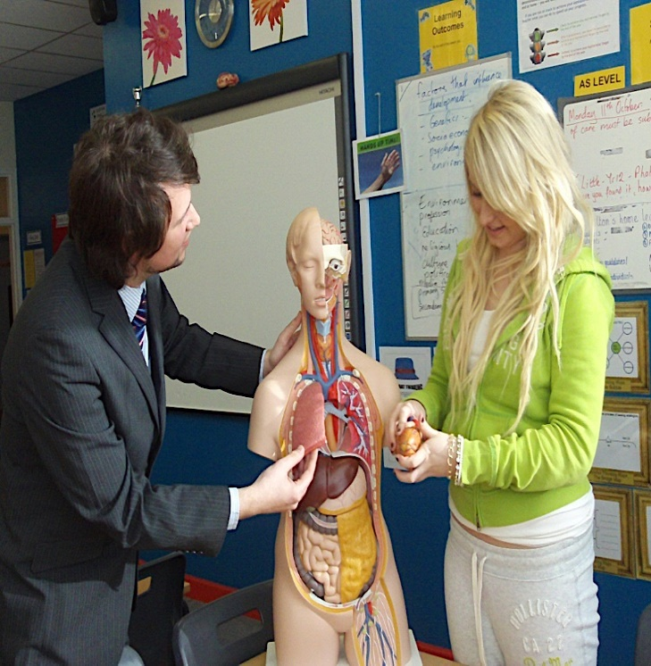

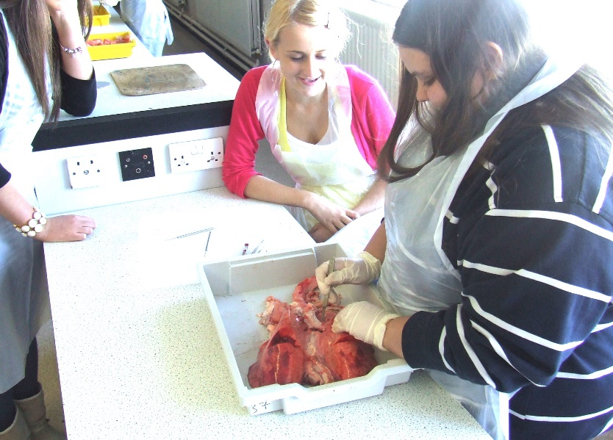
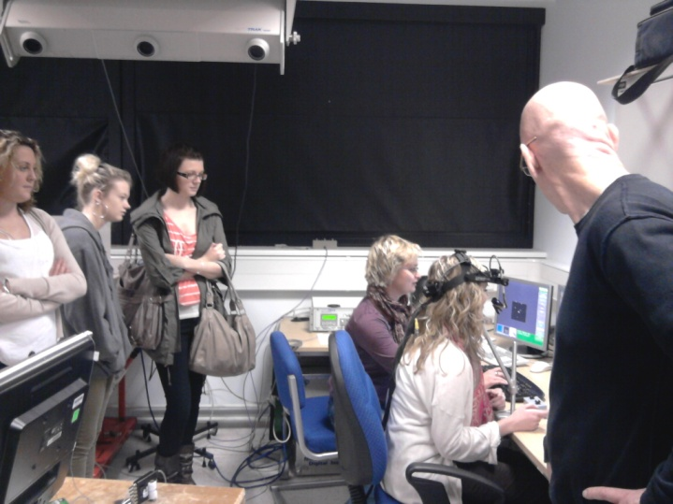
HEALTH AND SOCIAL CARE
CAMBRIDGE TECHNICALS LEVEL 3
This course gives students the opportunity to learn about the Health and Social Care sector. It has been developed to provide students with an introduction to the skills, knowledge and understanding required to prepare for a career in this area, or to allow students a progression route to other courses at a later date.

Slide 4
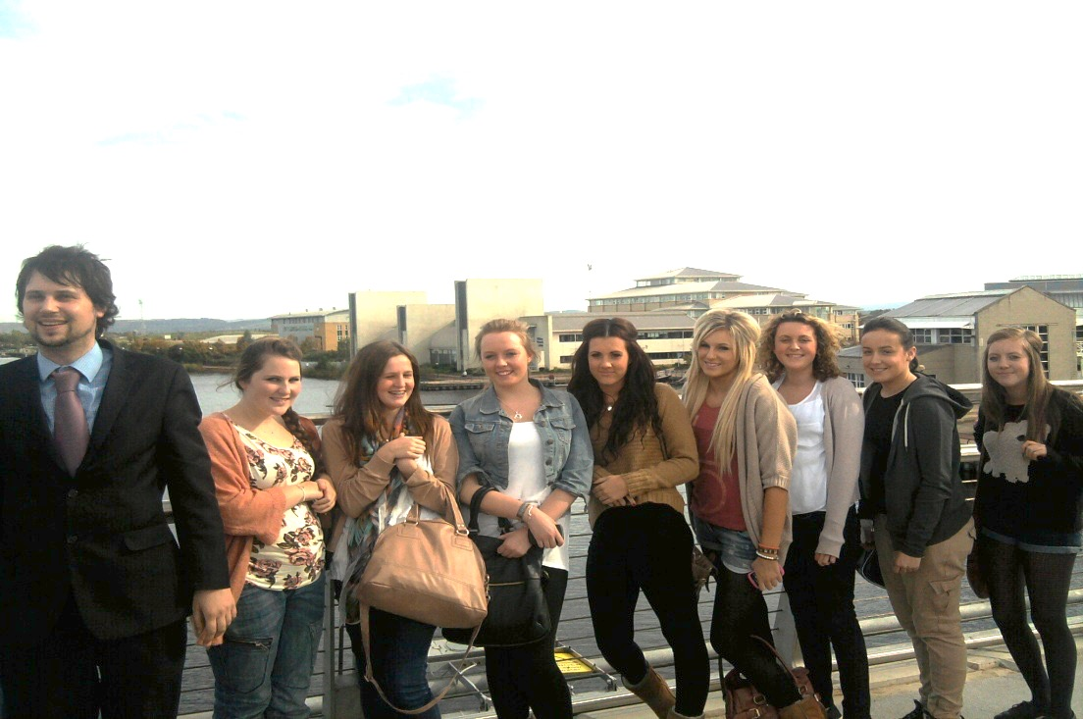
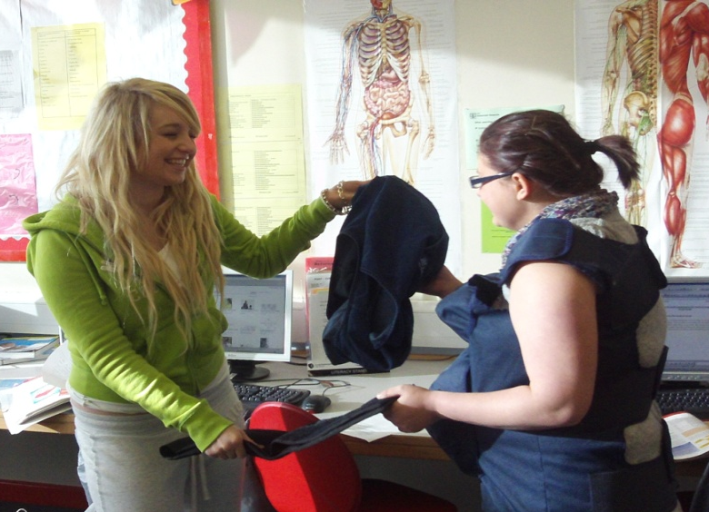
HEALTH AND SOCIAL CARE
CAMBRIDGE TECHNICALS LEVEL 3
A respected qualification that offers a ‘real-world’ vocational approach.
The course allows students to carry out a range of tasks and has been designed to include a modern practical element, relevant to the workplace.

Slide 5
SINGLE HEALTH AND SOCIAL CARE
Level 3 Cambridge Technical Extended Certificate
Worth the equivalent of 1 A level grade.
11 periods over a fortnight
6 units of work in total- 3 per year
A total of 3 examined units and 3 coursework units over two years
DOUBLE HEALTH AND SOCIAL CARE
Level 3 Cambridge Technical Diploma
Worth the equivalent of 2 A level grades.
22 periods over a fortnight
14 units of work in total- 7 units per year
A total of 5 examined units and 9 coursework units over two years

Slide 6
YEAR 12 HEALTH AND SOCIAL CARE
Equality, diversity and rights in Health and Social Care
EXAM
Building positive relationships in Health and Social Care
Health, Safety and security in Health and Social Care
EXAM
COURSEWORK
Nutrition for Health
COURSEWORK
Creativity and activity for children and young people
COURSEWORK
Personalisation and a person-centred approach
EXAM
Career planning for health and Social Care.
COURSEWORK
90 minutes
90 minutes
90 minutes
SINGLE OPTION UNITS – 3 UNITS PER YEAR
DOUBLE OPTION UNITS- 7 UNITS PER YEAR

Slide 7
YEAR 13 HEALTH AND SOCIAL CARE
Anatomy and Physiology for Health and Social Care
EXAM
Public Health
COURSEWORK
Psychology for Health and Social Care
COURSEWORK
Safeguarding
EXAM
Infection Control
COURSEWORK
Promote Positive Behaviour
COURSEWORK
Sexual health, reproduction and early development stages
COURSEWORK
90 minutes
2 hour exam
SINGLE OPTION UNITS – 3 UNITS PER YEAR
DOUBLE OPTION UNITS- 7 UNITS PER YEAR

Slide 8
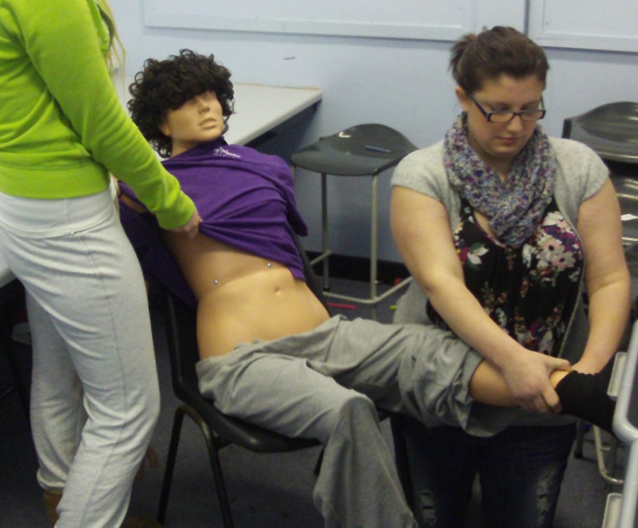
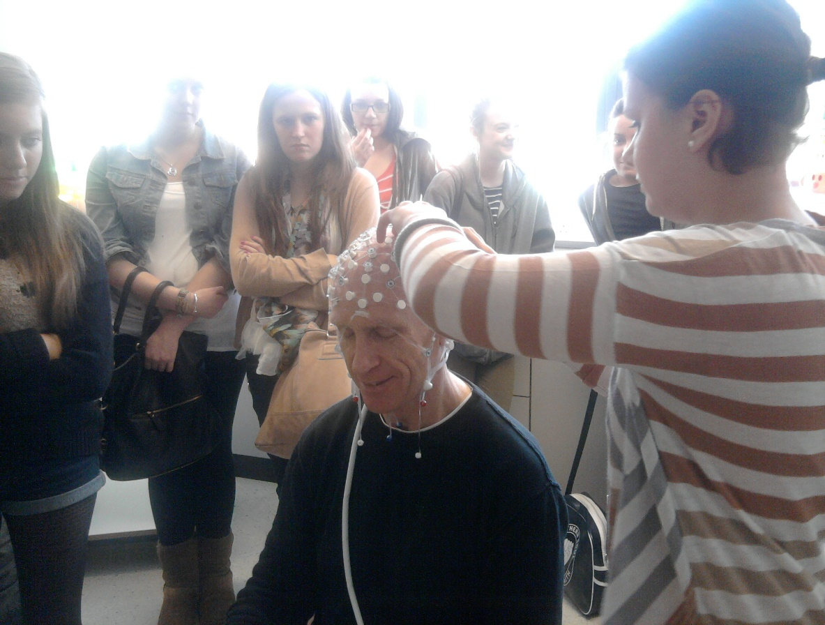
Should I pick Single or Double?
Advice:

