Slide 1
A Level History
What will I be studying?

Slide 2
A-level History A-level students must take assessments in all three of the following components:
• Component 1: Breadth study 40%
• Component 2: Depth study 40%
• Component 3: Historical investigation (Personal study) 20%
Students must:
• study the history of more than one country
• study a British history option
• study a non-British history option
• study topics from a chronological range of at least 200 years.

Slide 3
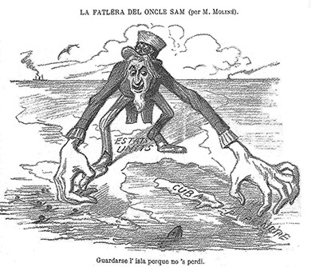
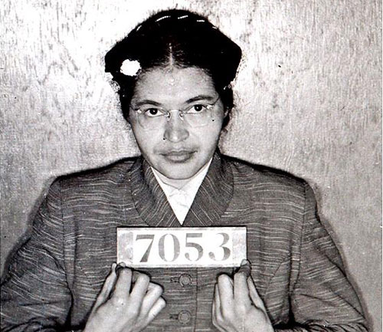
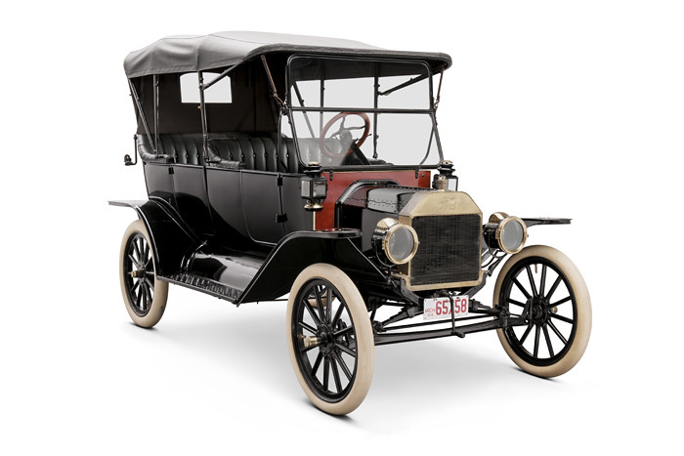
BREADTH STUDY The making of a Superpower: USA, 1865–1975
Component 1: Breadth study
The study of significant historical developments over a period of around 100 years and associated interpretations.
• written exam: 2 hours 30 minutes
• three questions (one extract and 2 essays)
• 80 marks
• two sections
• Section A – one compulsory question linked to historical interpretations (30 marks)
• Section B – one from two essays (2 x 25 marks)

Slide 4
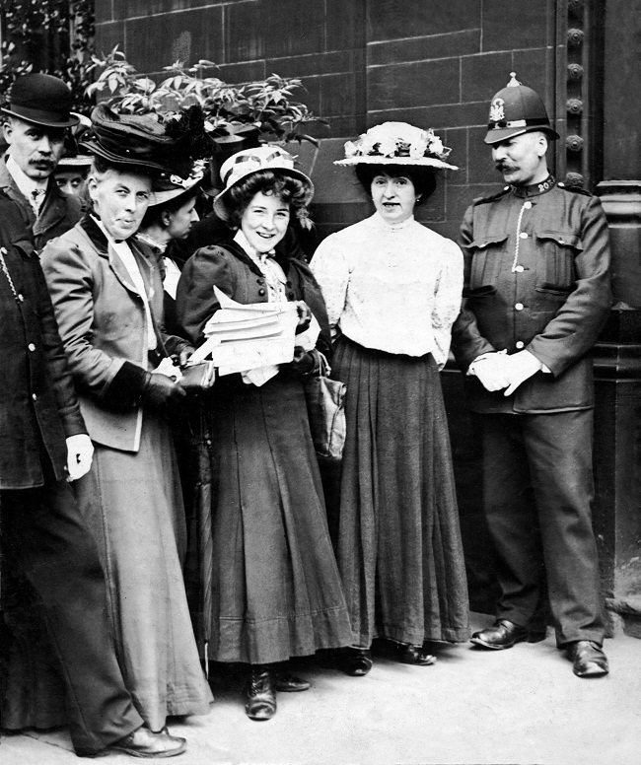
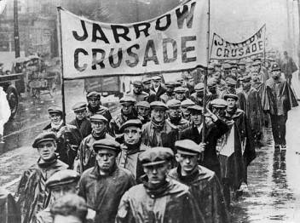
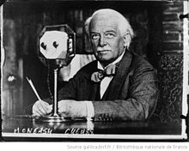
DEPTH STUDY Wars and Welfare: Britain in Transition 1906-1957
Component 2: Depth study
The study in depth of a period of major historical change or development and associated primary evidence.
• written exam: 2 hours 30 minutes
• three questions (one source and 2 essays)
• 80 marks
• two sections
• Section A – one compulsory question linked to historical source (30 marks)
• Section B – one from two essays (2 x 25 marks)

Slide 5
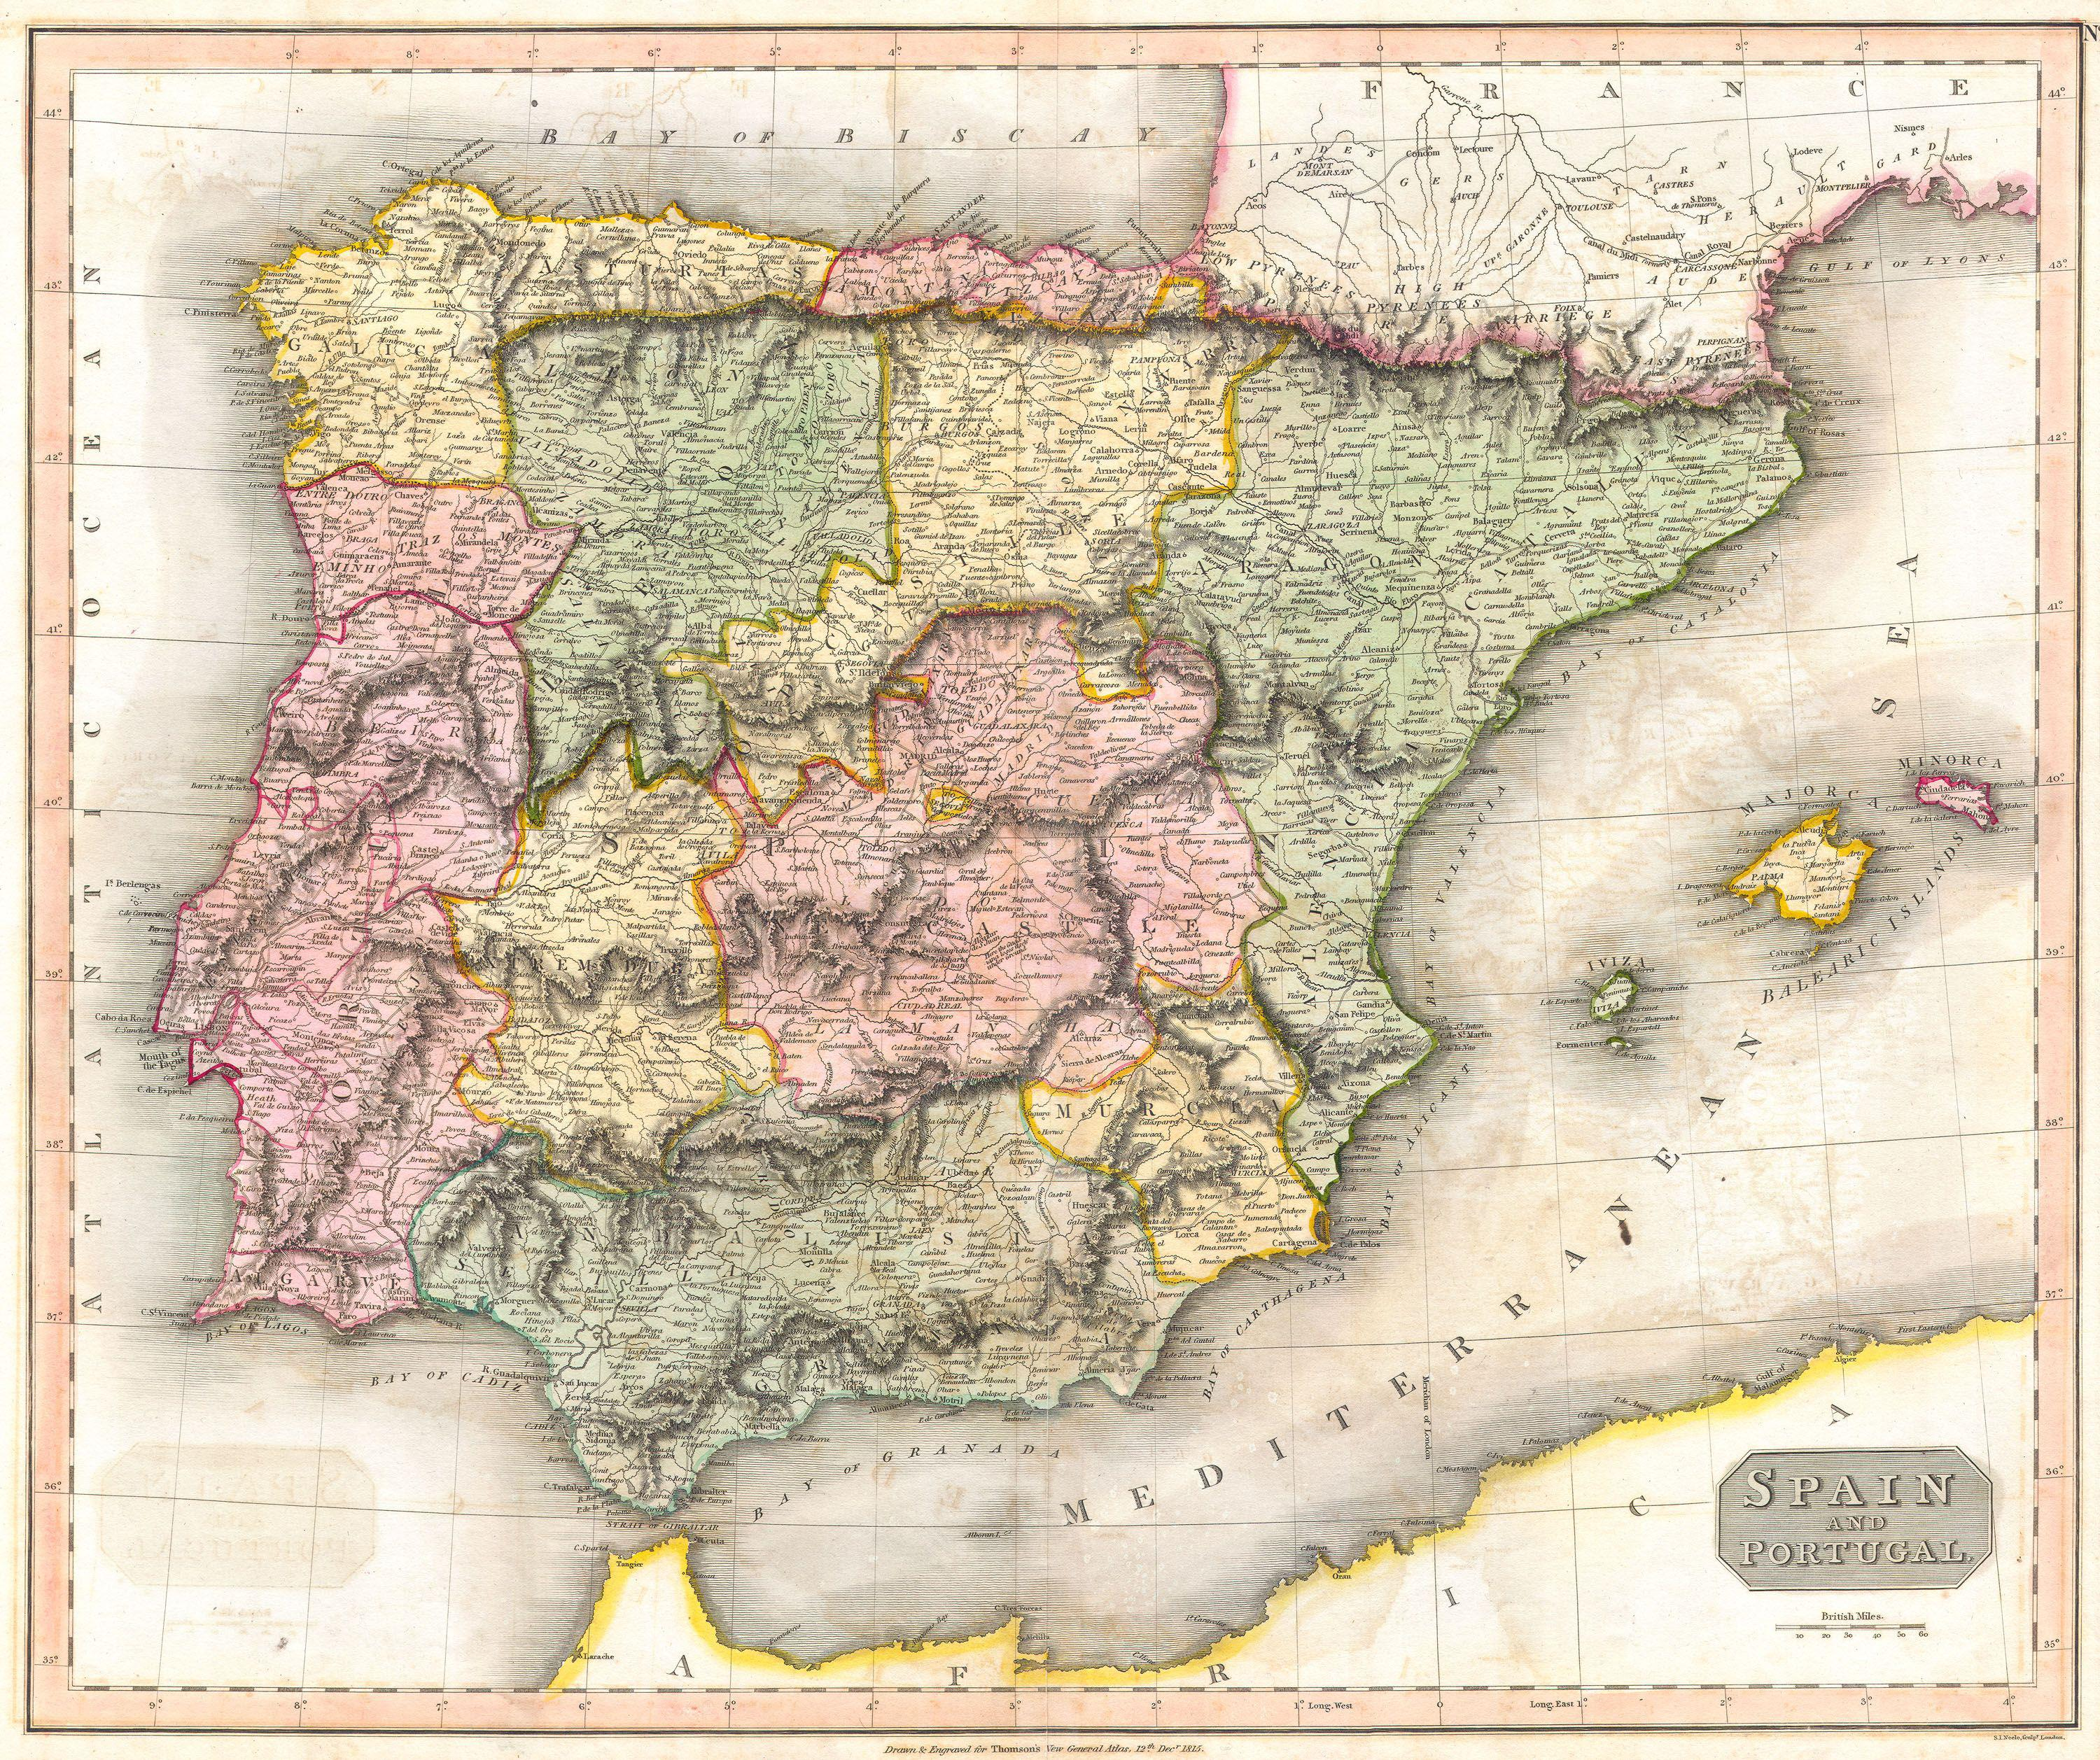
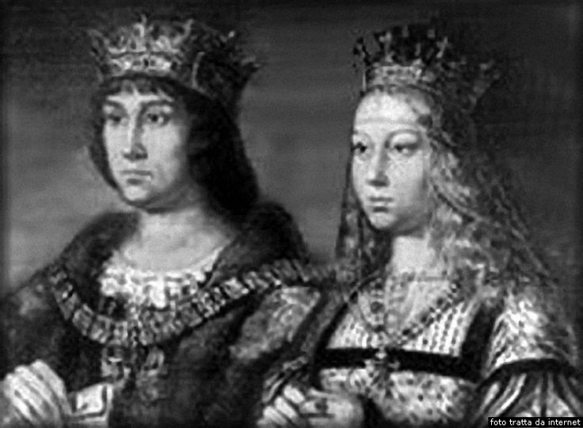
HISTORICAL INVESTIGATION Spain 1469-1598;Ferdinand and Isabella, Charles I and Phillip II
Component 3: Historical Investigation
A personal study based on the chosen topic.
This should take the form of a question in the context
of approximately 100 years.
• 40 marks
• 20% of A-level
• marked by teachers
• moderated by AQA
(3,000–3,500 words)
The study will utilise skills used in both papers - source evaluation, historical interpretation and essay writing/ analysis. Working independently, under teacher supervision to produce a sophisticated and analytical piece

