Slide 1
Welcome to this virtual taste session for
A-Level Biology

Slide 2
Learning Objectives
Gas exchange in fish
Relate the structure of fish gills to their function
Compare parallel and counter current flow in terms of the rate of gas exchange they generate
Draw a diagram of fish gills and label the parts and what they do

Slide 3
Fish Gills
Oxygen is much less available in water than in air
Water 10ml oxygen per litre of water
Air 200ml oxygen per litre of air
Diffusion of Oxygen is much slower in water than air
More energy is required to move water to gas exchange surfaces
Gas exchange system must...
...be extremely efficient
...have a diffusion surface no greater than 1mm thick
Gills
Provide a high surface area for diffusion of gases between water and the blood supply
(can be external in some newts. Mainly internal - bony fish)

Slide 4
(Gill covering –
protects gills
and controls water flow)
Water

Slide 5
https://www.youtube.com/watch?v=gX_PERXBooI

Slide 6
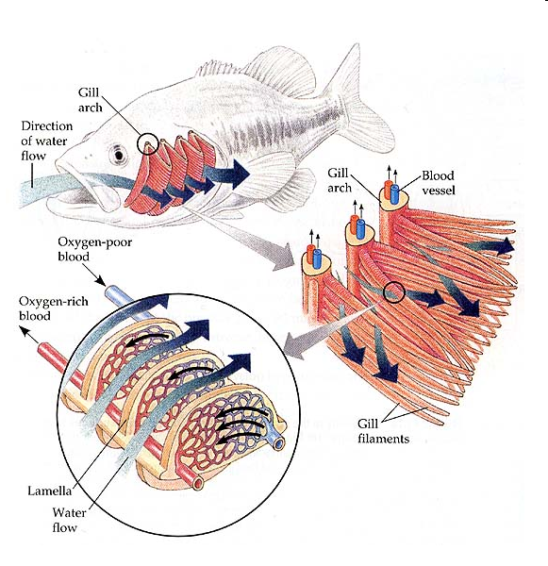
Gill Structure

Slide 7
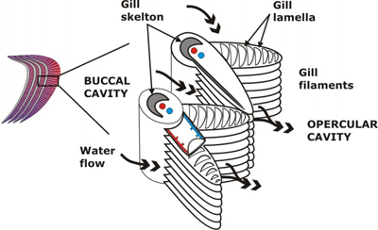
How is the structure of the gills related to its function?
Think:
Specialised exchange surface
SA/V ratio
Counter-Current Blood flow
Short Diffusion Pathway

Slide 8
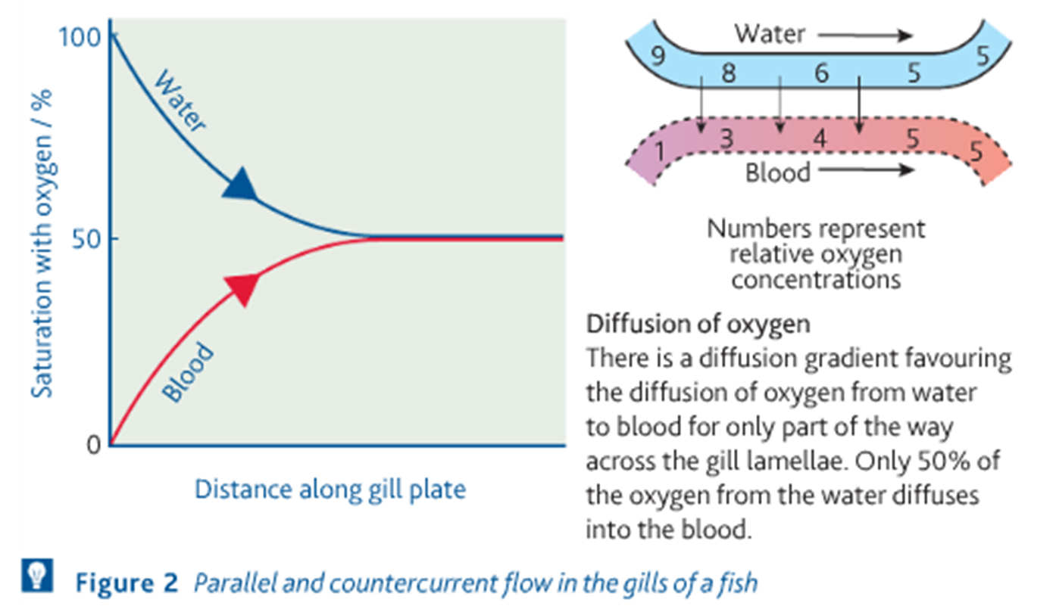
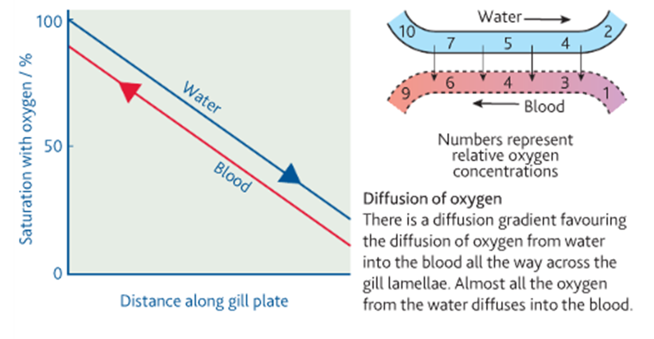
Concurrent / Parallel Flow
Counter-Current Flow

Slide 9
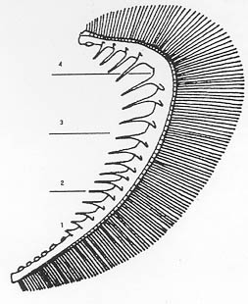
Biological Drawing
The purpose of drawing in the teaching of Biology is the development of observational skills.
A student must look very closely at a specimen in order to draw it accurately and must have sound knowledge of the component structures in order to choose what to draw and what to omit from the drawing.
Drawings should always be in pencil.
The outlines of any structures should be drawn but there should be no colouring or shading.

Slide 10
Plenary - Exam Q 1
Mackerel are fast swimming fish whereas toadfish only swim slowly.
The table shows some features of the gills of these fish.
Use evidence from the table to explain how mackerel are able to swim faster than toadfish. (3 marks)
 | Thickness of lamellae / µm | Number of lamellae per mm of gill length
Mackerel | 5 | 32
Toadfish | 35 | 8

Slide 11
Mark Scheme
(b) large numbers of lamellae so large SA;
lamellae thin so short (diffusion) pathway to blood/capillaries;
high rate of oxygen uptake for respiration/energy release; [3 marks]
(accept more oxygen)
[total 5 marks]

Slide 12
Exam Q 2
(b) Explain why countercurrent flow is more efficient for gas exchange than parallel flow. [2 marks]
Concentration gradient maintained over whole lamella;
Diffusion gradient maintained / oxygen taken up over whole lamella;
Equilibrium never reached; 2 marks max

