Slide 1
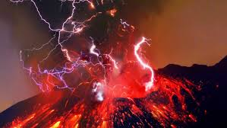


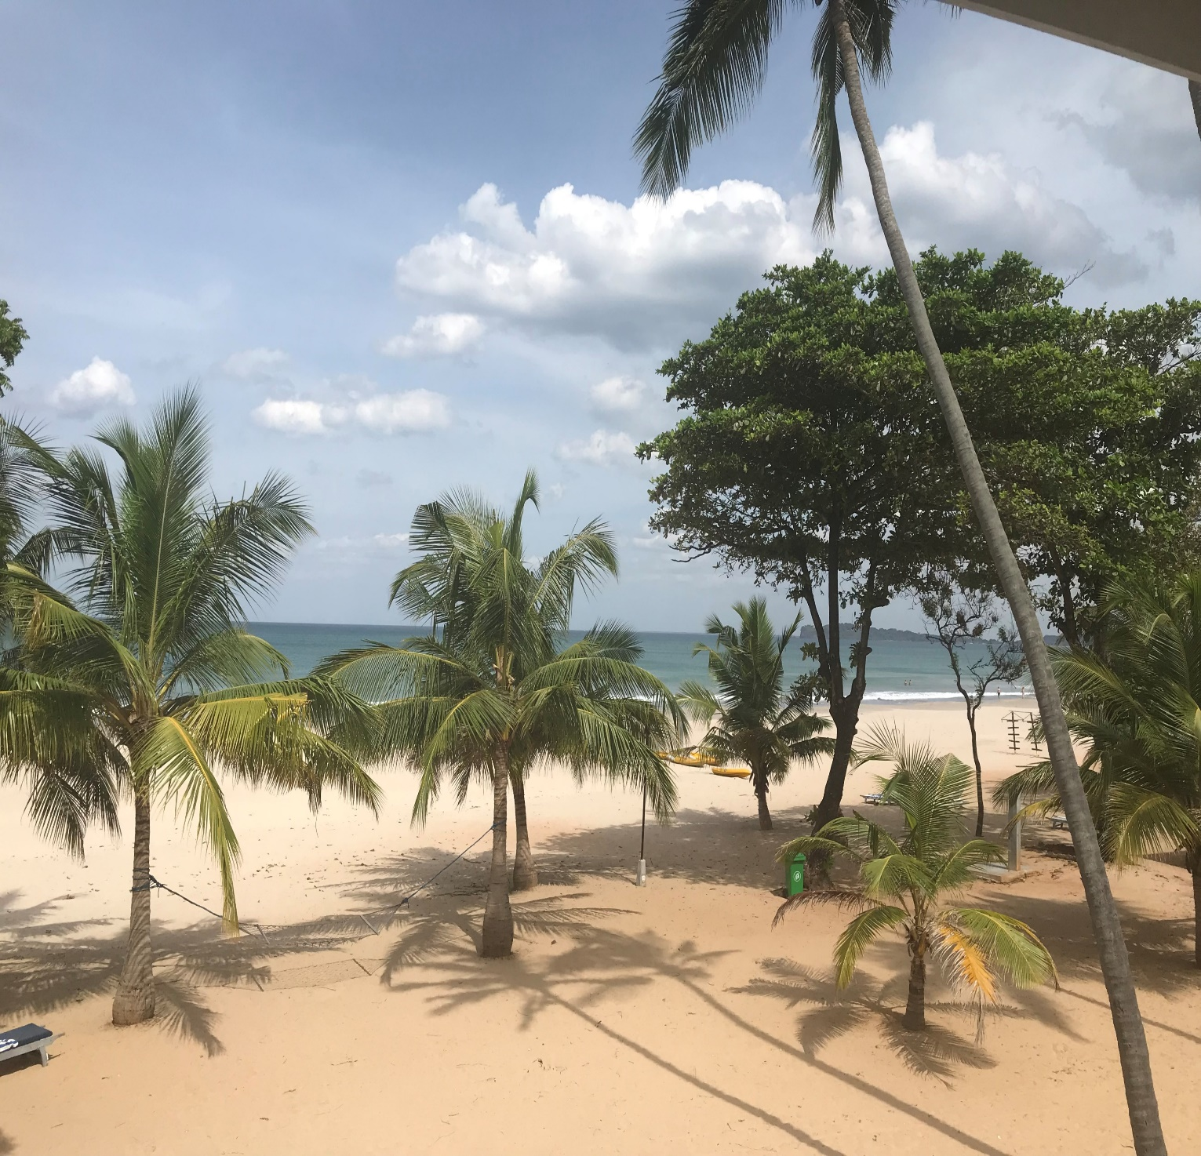
AQA A Level Geography

Slide 2

Why chose AQA A Level Geography?
Geography is for those interested in the world around them, and how people and the environment interact. It is suitable for those interested in the sciences and natural sciences, but for those who want to focus on actual places and real-life situations, taking in traditional and contemporary issues. By studying Geography at A- Level, you will develop a deep understanding of the world around you and how it can change.
Allows you to explore the world, its issues and their place in it.
The Russell Group report names Geography as one of the eight facilitating subjects. This is a subject most likely to be required or preferred for entry to degree courses and choosing facilitating subjects will keep more options open to you at university.
Geography combines well with both arts and science subjects. Geography is highly valued by universities as an A Level choice.
Explores current issues of local, national and global importance in contexts specific to different parts of the world. A-level Geography introduces new content and approaches to geographical processes, systems, place, scale and space.

Slide 3

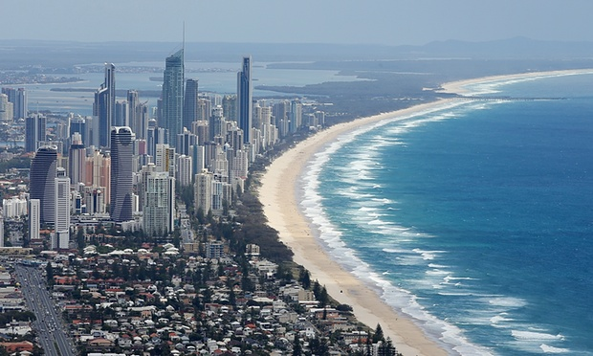
Why chose A Level Geography?
Geography is not only up-to-date and relevant, it is one of the most exciting, adventurous and valuable subjects to study at A level. So important, in fact, that the Guardian newspaper in 2015 named Geography as a ‘must-have A-Level’ to help you make sense of the world.
“Geography is all the rage.”
“Geography is a subject for our times.”
“Geography is soaring in popularity.”

Slide 4
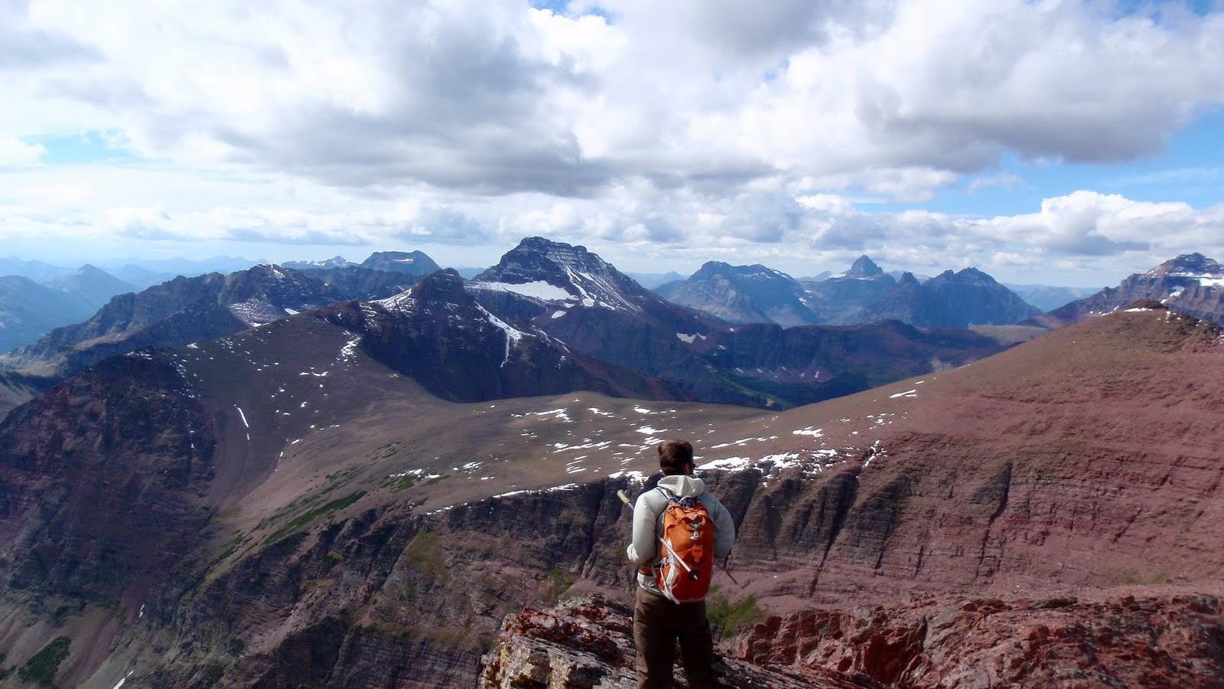
debating and arguing your point
fieldwork
modern computer based mapping
interpreting photos, cartoons, diagrams…
map skills
working with data
statistics
digital technologies
convincing others you are right
critical analysis
decision making
analysing articles
investigating issues in the real world
report writing
problem solving
empathy
boosting your memory
a wide variety of
SKILLS
Notes:
Such a wide variety of skills gained in Geography will be useful after school. These skills are highly sought after by Sixth Form Colleges, universities and employers.

Slide 5
What do you study?
Year 12
Coasts
Changing Places
Hazards
Water and carbon
Year 13
Globalisation
Population and the environment
We finish the course at February half term in Year 13. Lots of time for revision and reviewing examination technique.
Geographical investigation (20%)

Slide 6
Examination Overview
Physical Geography paper – 2 hours 30 minutes
Human Geography paper- 2 hours 30 minutes
Geographical investigation 20%

Slide 7
Track record
For the past 6 years we have been one of, if not the top performing A Level subject.
The majority of students over-perform in A Level Geography.
Year | % Grade A/A* | % Grade B+ | % Grade C+
2019 | 42 | 84 | 100
2018 | 12.5 | 62.5 | 87.5
2022 -
100% A*-A!

Slide 8

Where can Geography take you?
Geography is considered both a science and an art subject and as a results compliments any combination of A Levels.

Slide 9

Unemployment rate (2018-2019):
IT 9.4%, Physics 7.6%, Maths 7.5%
Biology 6.0%, DT 6.8%, Chemistry 6.3%, Arts 6.6%, Business Studies 6.1%, History 5.7%, English 5.4%, History 5.7%, Average unemployment 5.1%, Geography 4.8%
(six months after graduation)
Great job
PROSPECTS
Geographers do not struggle to get a job! If you study Geography at any level – GCSE, A Level and or degree level, this is a good thing!
Notes:
Geographers do not struggle to get a job! If you study Geography at any level – GCSE, A Level, uni, this is a good thing!

Slide 10
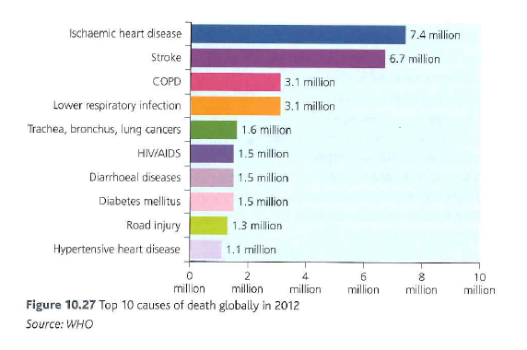
Population and Environment Unit – A taster of what you will be learning.
What are the leading causes of death across the world?
Think:
What are the top 10 causes of death across the world?
What are the top 10 causes of deaths in LICs?
What are the top 10 causes of deaths in HICS?
Do the causes of deaths differ between LICS and HICs? If so why?

Slide 11
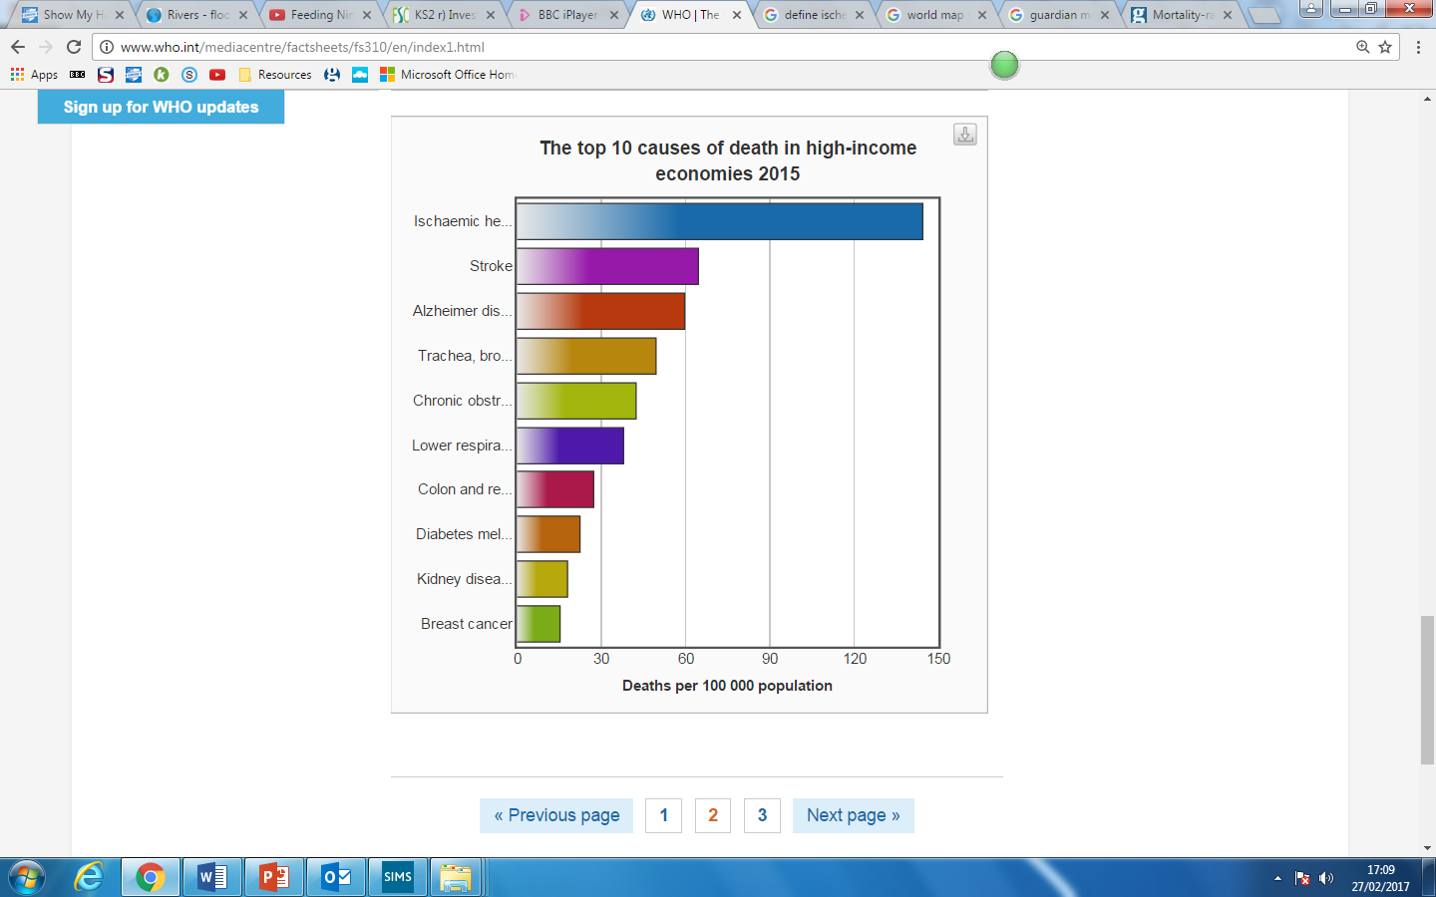
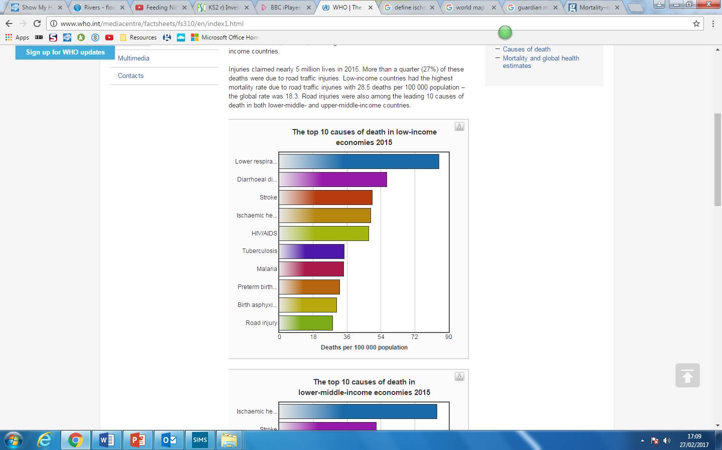
What are the differences between LICs and HICs causes of death?
Studies show that a healthy environment improves well being and quality of life. The characteristics of a healthy environment differ between HICs, NEEs and LICs
More than half (514) of the 100 deaths in HICs are caused by just 10 conditions as shown below.
Non- communicable diseases (NCD): A medical condition or disease that is by definition non-infectious and non-transmissable among people e.g. cancer, diabetes, obesity and CHD.
Communicable diseases infectious diseases that can be passed on e.g. AIDs and malaria.

Slide 12


The global prevalence and distribution of malaria
What do these posters tell us about malaria?
Learning outcomes:
To examine global patterns of malaria.
To assess the impact of malaria on health and well-being.
To examine management and mitigation strategies of malaria.
https://www.youtube.com/watch?v=Jt5u1lX9yZI&t=88s
http://video.nationalgeographic.com/video/malaria-sci

Slide 13
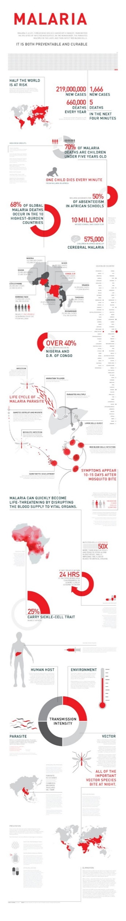
Malaria Facts
Contact details:
Miss K Bailey Curriculum Leader: Geography
kbailey@gshs.org.uk
Miss J Harrison Teacher of Geography
jharrison@gshs.org.uk

