Slide 1
Psychology
Ms Bennett, Miss Rigby & Mr Grange

Slide 2
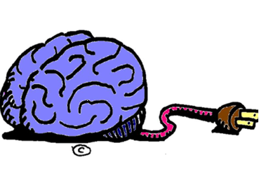
What exactly is psychology? Is it ethical to study human behaviour? Is psychology a science? Is your behaviour due to nature or nurture? Do you have free will?

Slide 3
What is Psychology?
Psychologists attempt to investigate and develop theories about reasons why behaviour occurs. They conduct research to test the theories then report their findings. Psychology is recognised as a science due to the amount of research involved in the study of human behaviour. It is important that you have an interest in studying people and that you realise that there is never a ‘right’ answer.

Slide 4
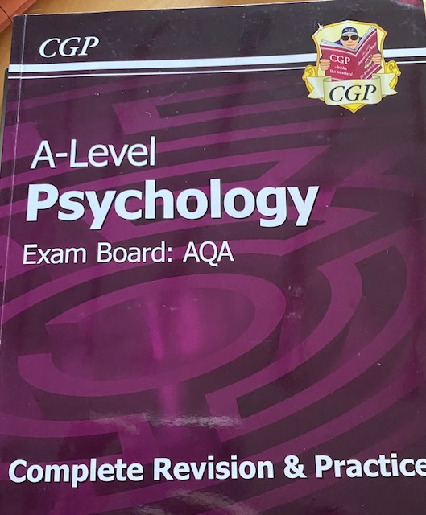
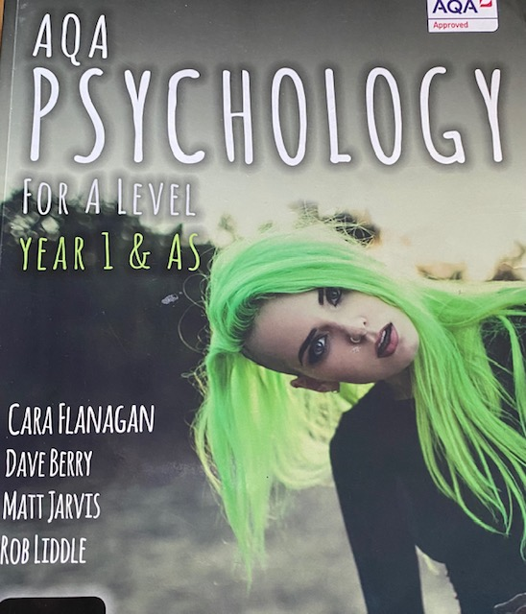
What is Psychology?
Psychology is a fascinating and diverse subject that enables students to gain insights into the human mind and behaviour.
The course places an emphasis on understanding research and this will account for nearly half your total marks, so if you do not like science you may find this subject is not for you. Secondly, you will learn what psychologists know about human behaviour.
Psychology is a subject which compliments many other A levels, there is a particular overlap with Sociology and Biology.

Slide 5
What will I study?
Students no longer sit a formal exam in year 12, but you will be sitting a mock exam which will replicate this. ​
​
We expect the same level of revision and attitude towards these mocks as these will help US help YOU.​
You will sit 3 exams in Year 2 usually in June over the course of 3 weeks(1 exam a week).​
Our optional units are:​
Forensic, Gender and Schizophrenia.

